Slide 1
TITLE
FLIGHT TICKET BOOKING APP
TEAM MEMBERS
KAVIDEEPA E
DHARUNIKA P R
HARINI SREE K
JAAHNAVI K

Slide 2
ABSTRACT
This project presents a flight ticket booking system built with the MERN stack
(MongoDB,Express.js, React, Node.js) to provide a seamless platform for users to search, compare, and
book flights. The application features a responsive user interface developed in React, allowing users to
easily input travel details and view available flights. The backend, powered by Express.js and
Node.js, manages user requests and booking processes while interfacing with a MongoDB database to
store and retrieve flight information, user profiles, and transaction histories. Security measures, including
user authentication and data encryption, are implemented to protect sensitive information, ensuring a
secure booking experience. This project showcases the potential of the MERN stack in developing
efficient and user-friendly web applications for travel services.

Slide 3
INTRODUCTION
The flight ticket booking system developed using the MERN stack (MongoDB, Express.js, React, Node.js) aims to revolutionize the way users search for and book flights online. In an era where convenience and efficiency are paramount, this application provides a user-friendly interface that simplifies the process of finding and purchasing flight tickets. Leveraging the power of React for a dynamic frontend experience, Express.js for a robust backend API, and With a focuMongoDB for scalable data management, the system allows users to easily input their travel preferences, view real-time flight options, and complete bookings securely. s on enhancing user experience through intuitive design and rapid performance, this project exemplifies the capabilities of modern web technologies to meet the evolving needs of travelers in the digital age.

Slide 4
PROPOSED SYSTEM App Features:
Flight Search: Users can search for flights by entering the departure and destination cities, dates, travel class, and the number of passengers.
Seat Selection: Once a flight is selected, users can choose their preferred seat from an interactive seat map.
Payment Processing: Integrated secure payment gateway for booking confirmation.
Booking Confirmation: After successful payment, users receive a confirmation with an e-ticket and itinerary details.
User-Focused Design: The app is designed with user convenience in mind, offering quick results, detailed flight information, and real-time assistance during the booking process.

Slide 5
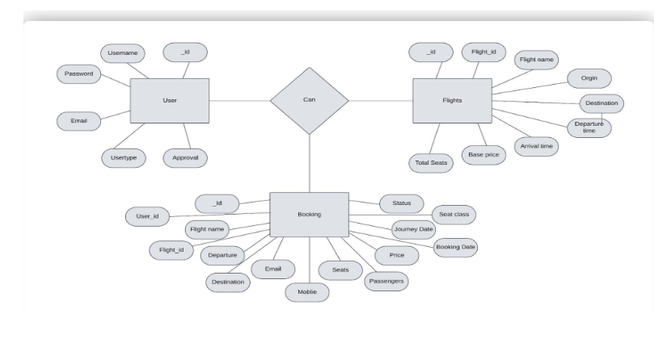
ER DIAGRAM:

Slide 6
Frontend Components
HTML and CSS: The frontend is built using HTML for structure and CSS for styling, providing a clean and responsive user interface.
Main Components:
Search Form: A form where users input their travel details.
Flight Results: Displayed in a list, showing available flights with relevant details.
Seat Selection: An interactive seat map where users can choose their preferred seat.
Payment Section: A form for secure payment input.
Booking Confirmation: Displays the booking details and confirmation message after successful payment.

Slide 7
Backend Design
Node.js and Express: The backend uses Node.js and Express to handle routing, server-side logic, and API requests.
API Endpoints:
1. Users: Handles user registration, authentication, and profile management.
2. Flights: Fetches flight data based on search criteria entered by the user.
3. Bookings: Manages flight bookings, seat selections, and payment processing.
4.Admin Panel: Provides a dashboard for the admin to manage flights, users, and bookings.
RESTful Services: Each endpoint follows RESTful principles, ensuring easy scalability and
maintainability of the backend.

Slide 8
Database Structure
MongoDB Collections: The app uses MongoDB for data storage, providing flexibility and scalability.
Key Collections:
1.Users: Stores user information such as name, email, and booking history.
2. Flights: Stores flight details, including airline, destination, price, availability, and schedule.
3.Bookings: Contains booking records, linking users to specific flights and seats, along with payment status.
Efficient Data Retrieval: Optimized queries ensure fast retrieval of flight and booking data to enhance user experience.

Slide 9
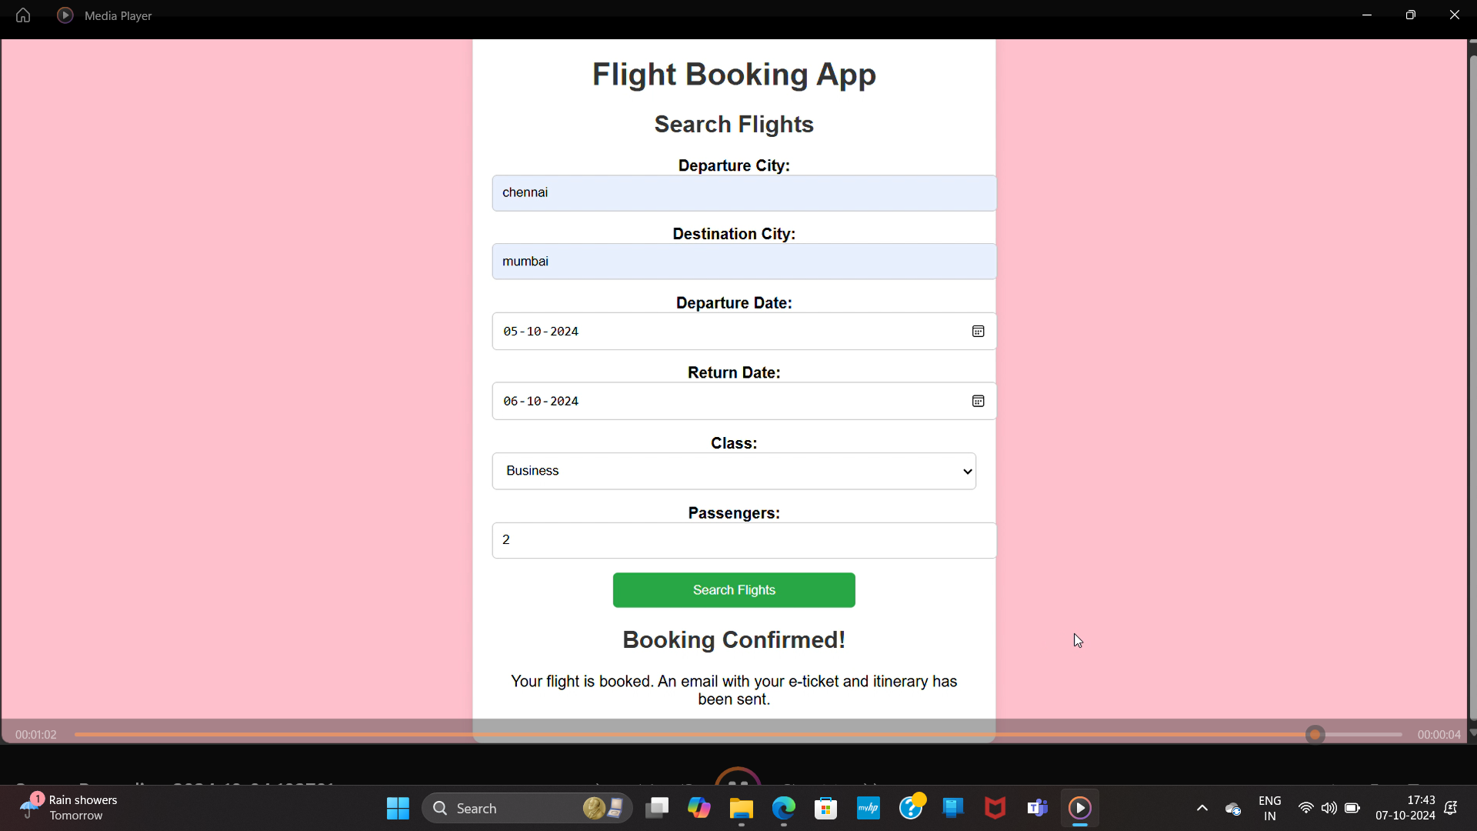
RESULT

Slide 10
CONCLUSION
Project Summary:
The Flight Booking App simplifies the flight booking process, offering a user-friendly interface, reliable backend, secure payment gateway, and a seamless booking experience.
Future Enhancements:
Real-time flight tracking for ongoing bookings.
Frequent flyer programs for user rewards and discounts.
Expanded filter options for more personalized flight search experiences.
Improved user feedback system to continually enhance the app based on user suggestions.

Slide 11
THANK YOU!

